Slide 1
Archaeological Fieldwork and Family Life: Assessing the Challenges and the Rewards
Gretchen E. Meyers and Stephanie McNulty
Franklin & Marshall College

Slide 2
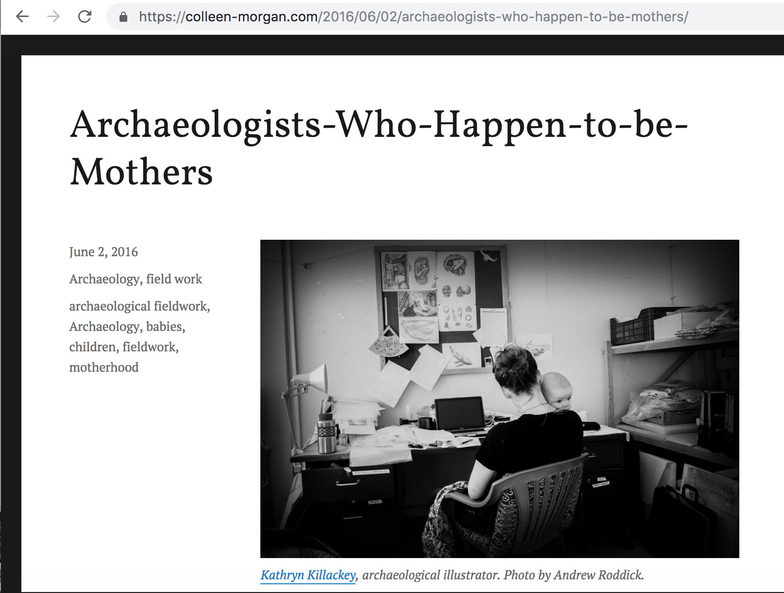

Slide 3
Archaeological Fieldwork and Family Life: Assessing the Challenges and the Rewards
Gretchen E. Meyers and Stephanie McNulty
Franklin & Marshall College

Slide 4
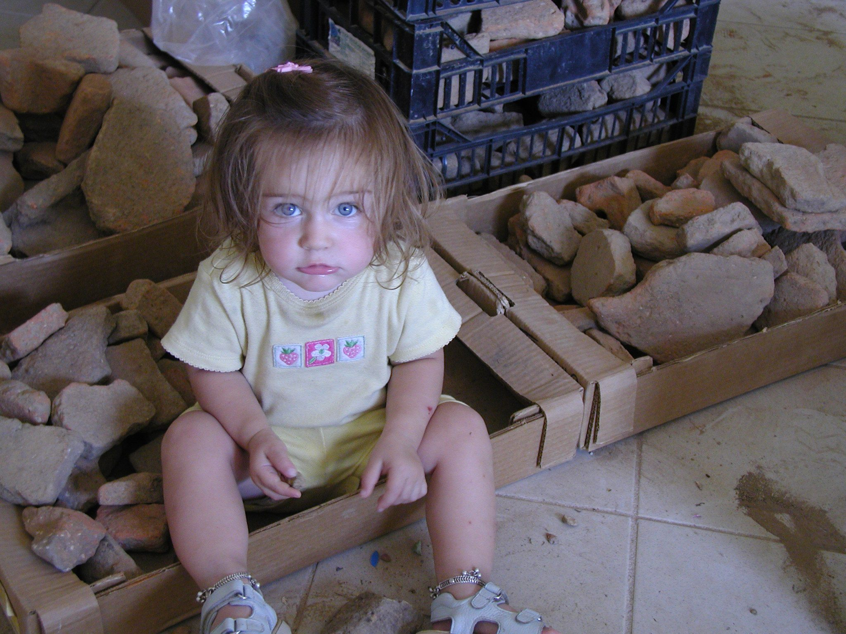
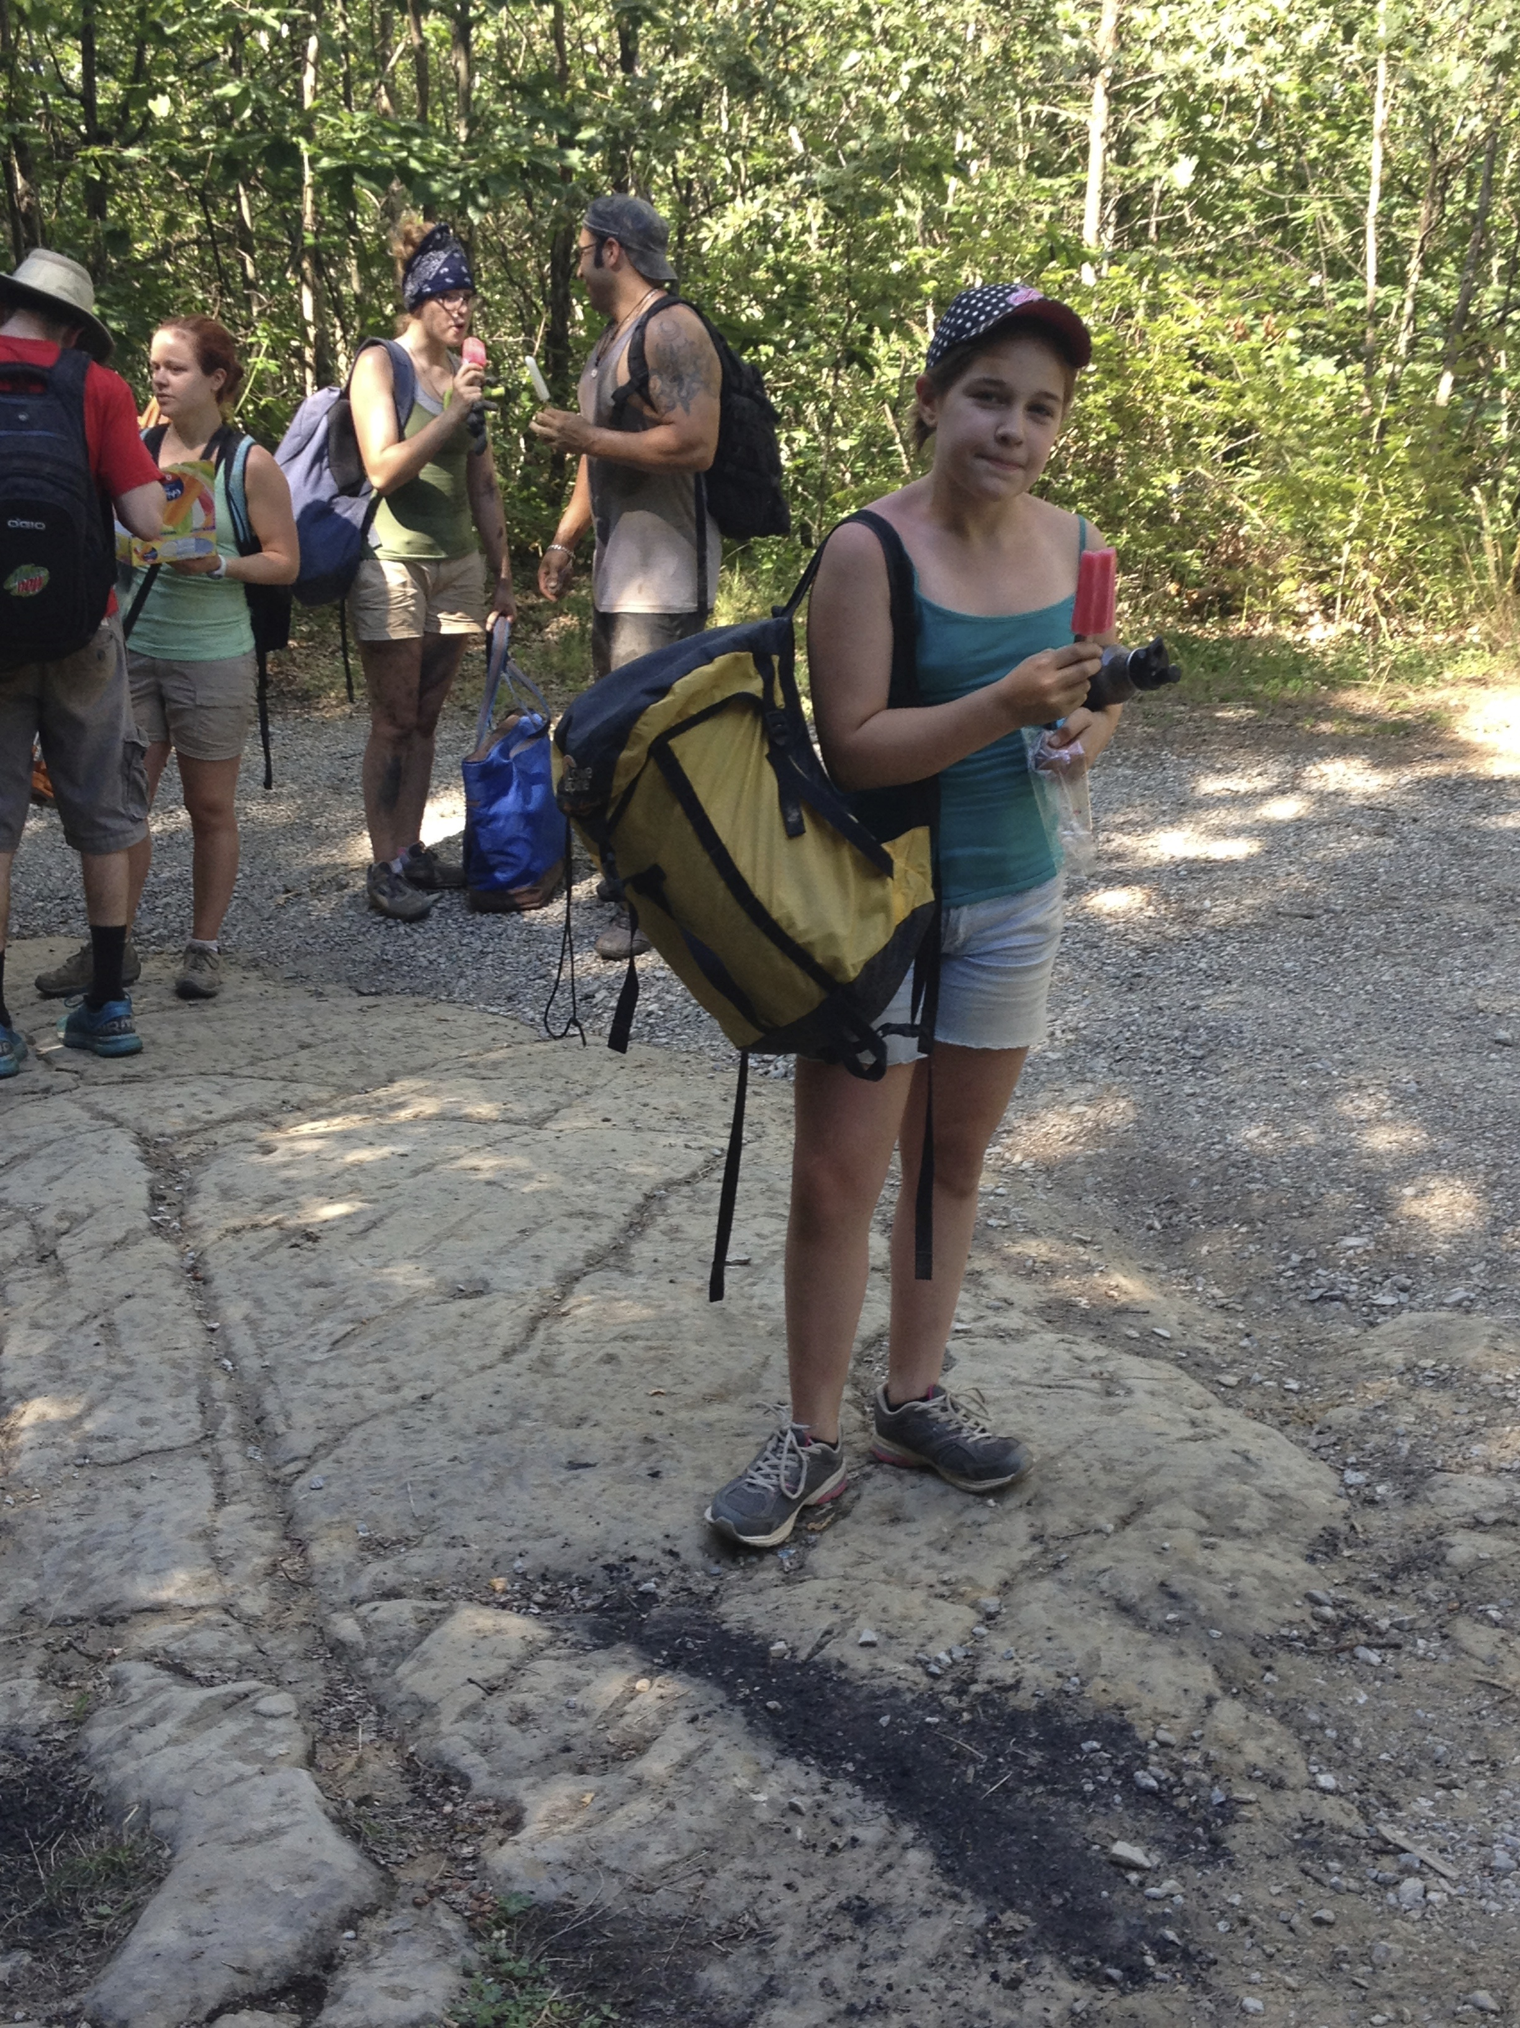
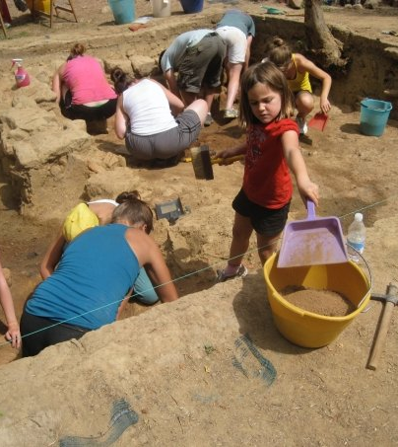
Gretchen’s story

Slide 5
Methodology
Part I: The Survey
Administered through professional associations, social media, word of mouth
480 people completed the survey (171 male and 309 female)
Age
  20-35: 117
  36-50: 259
  51+: 124
  Fields represented: Sociology (52), Biology (155), Archaeology (13), Political Science (28), Physical Sciences (11), Geological Studies (16), Anthropology (11)
Institution
  Community College: 5
  Four year undergraduate: 89
  Graduate degree granting: 317
  Other: 63
Notes:
Goal of the survey – interdisciplinary, perceptions, strategies

Slide 6
Methodology
Part I: The Survey
  312 have children, 95 do not have children
  181 take/have taken children to field (59%), 128 have not taken children to field (41%)
  Location of Research: North America (138), Latin America and Caribbean (82), Middle East and North Africa (12), Europe (64), East Asia/Pacific (30), South Asia (18), Africa (37)
Notes:
Survey details—who took, where we sent it
Workshops—Faculty center, AIA, LASA
Interviews

Slide 7
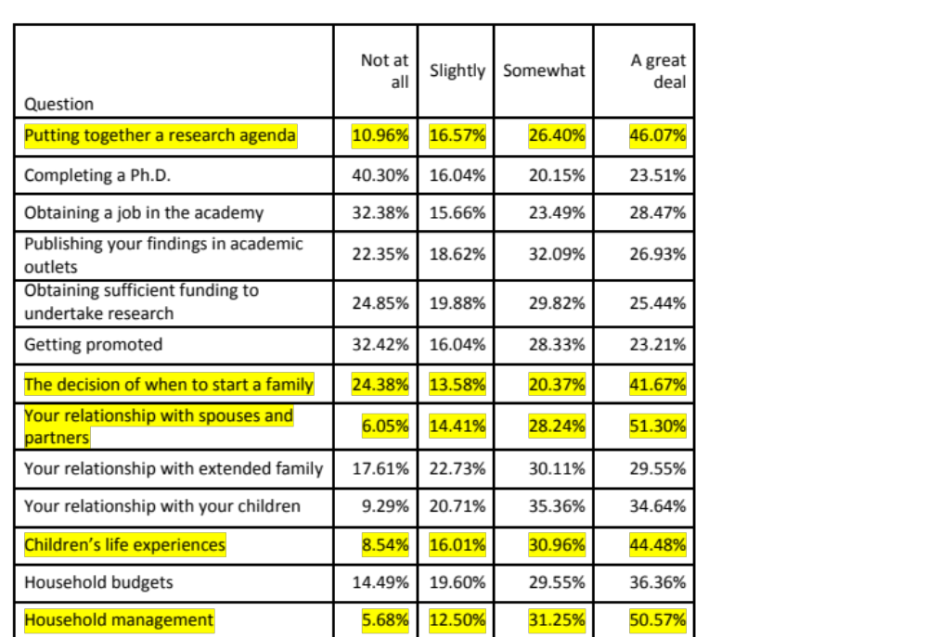
Perceptions of the Balance

Slide 8
Gender
 | Putting together research agenda |  | Obtain Funding |  | Getting Promoted |  | Deciding when to start a family |  | Relationship with Spouse and Partners |  | Relationship with children |  | Children's life experiences |  | Household Budget |  | Household Management
 | Coeff | SE | Coeff | SE | Coeff | SE | Coeff | SE | Coeff | SE | Coeff E | SE | Coeff | SE | Coeff | SE | Coeff | SE
Gender | .3** | 0.11 | 0.24 | 0.12 | .27* | 0.12 | .59*** | 0.14 | .4** | 0.13 | .27* | .12 | 0.22 | 0.12 | 0.22 | 0.12 | .42*** | 0.12
n= | 356 |  | 342 |  | 293 |  | 324 |  | 347 |  | 280 |  | 281 |  | 352 |  | 352
0 ‘***’ 0.001 ‘**’ 0.01 ‘*’
Notes:
Simple regression analysi

Slide 9
Making the Decision
What are factors that play a role in how scholars decide whether to take family into the field or leave them at home?
What are some of the rewards and challenges that result from that decision?

Slide 10
Findings
Several factors explain one’s choice about whether to take children/family members to the field:
  cost
  availability of high quality and reliable childcare
  family structure/age of children
  safety

Slide 11
Findings
Several factors explain one’s choice about whether to take children/family members to the field:
  cost
  availability of high quality and reliable childcare
  family structure/age of children
  safety

Slide 12
Findings
Several factors explain one’s choice about whether to take children/family members to the field:
  cost
  availability of high quality and reliable childcare
  family structure/age of children
  safety

Slide 13
Findings
Several factors explain one’s choice about whether to take children/family members to the field:
  cost
  availability of high quality and reliable childcare
  family structure/age of children
  safety

Slide 14
Findings
Several factors explain one’s choice about whether to take children/family members to the field:
  cost
  availability of high quality and reliable childcare
  family structure/age of children
  safety

Slide 15
“My kid found [a] rare species.”
Benefits: family
  Bonding.
  Exposure to new places and cultures.
  “My kids have gotten to see the world and have learned more about different cultures than any school could teach them. My youngest has lived on three continents and speaks two languages fluently as well as has some level of aptitude in three others.”
  Long-term career choices of (now) adult children.
Benefits: research agenda
  60% of our respondents did report a variety of positive effects on their research agenda.
  Reduced anxiety and guilt.
  Build trust with communities or improving connections with colleagues and interviewees.
  Extra set of eyes and hands.

Slide 16
Summary of Conclusions
There is no “one size fits all” way to balance fieldwork and family, many strategies work for academics and their children.
Men and women likely experience the demand to do fieldwork differently. This suggests that underlying biases are built in to any academic career that demands regular fieldwork. These previously hidden biases are made visible by this study.
Bringing children to the field and leaving children at home with loving caregivers both provide important and sometimes unexpected benefits to our research and children.
Institutional support for dependents and awareness from colleagues would go a long way in helping parents, especially women, manage the competing demands of family, fieldwork, and promotions.

